Slide 1
PRINCIPLES OF REDUCTION AND FIXATION OF FRACTURES

Slide 2
Learning Objectives
To define and classify fracture reduction and fixation techniques

Slide 3
AO/ASIF Principles of Fracture Management
Anatomical reduction of fracture fragments (articular)
Stable fixation suitable to biomech. & clinical situation
Preservation of blood supply to bone fragments and soft tissue (atraumatic reduction & surgical technique
Early active pain-free mobilization of muscles & joints adjacent to fracture to prevent developing fracture disease
Notes:
AO- Arbeitsgemeinschaft für Osteosynthesefragen
ASIF- Association of the Study of Internal Fixation

Slide 4
Clinical features associated with fracture disease
Joint stiffness
Muscle atrophy
Osteopenia
Poor limb use

Slide 5
Reduction
The process of replacing the fractured segments in their original anatomical position
Two approaches are used;
  Closed reduction involves traction and manipulation of the fragments without surgical exposure
  Open reduction involving surgical exposure and direct visual reconstruction of the bone

Slide 6
Closed reduction
When a bone is fractured, all opposing muscles contract maximally, leading to
  Overiding and shortening of the limb
  Spastic contraction of muscles is intensified by injury to soft tissues
Gas anaesthesia is superior to barbiturates in bringing about relaxation of muscle spasms

Slide 7
Healing is influenced by the
  Handling of soft tissues
  Blood supply to the fracture fragments
  Accuracy of reduction
  Efficiency of immobilization
Anatomical apposition is always preferred but not always necessary (especially shaft fractures)
Rotational alignment must be restored between joints proximal and distal to fracture to ensure good function

Slide 8
Methods of Closed Reduction
Apply slow continuous traction to the fragment that can be controlled, aligning it with the less manageable fragment
Be alert to possibility of lacerations, perforation or compression of a major vessel or nerve
Traction can be achieved via manual force or gravity

Slide 9
Open Reduction
Applicable in
  fractures that are unstable and more complicated
  Old fractures (several days old)
  Articular fractures
  Fractures that require internal fixation

Slide 10
Guiding principles
Gentle and efficient handling of soft tissues to preserve viability and potential for healing of soft tissue and bone
Strict hemostasis to
  control active bleeding in order to visualize surgical site
  Preserve the patient’s life and reduce postoperative complications
Follow normal separations btwn muscles and fascial planes

Slide 11
Severe muscles at tendon of insertion or near its origin; to
  minimize trauma and hemorrhage and
  Facilitate closure and minimize loss of muscular function
Surgical anatomy: knowledge of the location of major blood vessels and nerves
Avoid excessive traction on nerves as this could lead to temporary or permanent injury

Slide 12
Preserve soft tissue attachments (blood supply) to bone fragments during exposure, reduction and application of fixation devices
Use suction rather than blotting, to minimize soft tissue trauma
Blot with moist gauze sponges (Ringer’s solution). Avoid wiping

Slide 13
Methods of Open Reduction
Application of levering using instruments
Application of direct force (using bone holding forceps) on one or more bone fragments
Direct application of force on both the bone fragments. After the fragments are reduced by the application of traction, counter traction and corrective rotation, self-holding bone forceps are used to maintain temporary reduction while fixation is applied

Slide 14
Application of distraction forces through the bone-holding forceps
Direct application of force on both the bone fragments combined with the use of levering

Slide 15
FRACTURE FIXATION

Slide 16
Classification of fixation techniques
Definition:
  rigid immobilization of bone fragments in reduced position during the healing process
External fixation
  Orthopaedic bandages, Coaptation splints, Cast bandages
  External skeletal fixators
Internal fixation
  Intramedullary pins,
  Interlocking nails
  Orthopaedic wires
  Tension bands
  Bone plates and screws

Slide 17
The Full Leg Cast
Definition:
  A cast is a limb splint constructed with light padding and casting tape applied circumferentially to enclose an extremity rigidly
  Affords adequate stability for healing of fractures & joint conditions
  Encloses the limb from the toe to the:
    midshaft humerus in the forelimb or midshaft femur in the hind limb

Slide 18
Indications
Indications:
  Casts are most effective in treating
    Minimally displaced stable fractures of the radius, ulna, tibia and fibula in young fast-healing animals
    Additional fixation when Internal Fixation of fractures is less than optimal
    Displaced fractures require proper reduction and alignment before application of cast
Contraindications:
  Severely displaced fractures such as oblique fracture of the tibia
  Do not use a cast to enclose a fracture site rigidly when extensive soft tissue damage is present

Slide 19
Key Concepts in Applying Casts
Casts must span the joint above and below the fractured bone
Apply the cast with the leg held in slight varus and flexion
Excessive padding results in a loose cast after the padding compresses
Extend the cast distally to encompass the toes, leaving only the toenails of the middle digits exposed

Slide 20
EXTERNAL SKELETAL FIXATORS

Slide 21
Basic components
Original:
  Kirschner-Ehmer System (Veterinary Instrumentation)
Second generation Securos (Orthomed)
IMEX-SK (Animalcare)
Acrylic Pin External Fixator (APEF) System

Slide 22
The basic frame:
  created from pins driven percutaneously into the bone, and
  attached to one or more connecting bars placed outside body
Frame size
Small system: animals <5 kg
Medium system: animals 5-30kgs
Large system: animals > 30kgs
Basic rule:
  pin size should be chosen first; & should not exceed 25-30 % of the bone diameter

Slide 23
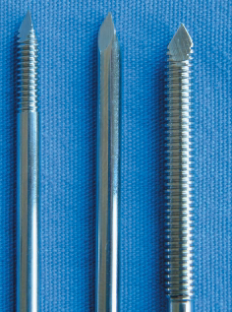
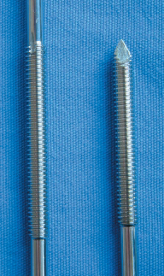
Notes:
External skeletal fixation pins are made of hardened stainless steel, and are stiffer and more resistant to bending than Steinmann pins. (A) Negatively threaded
Ellis pin. The threads are cut into the shank, making the pin relatively weak. The weakest point is the thread-shaft junction (arrow), which must be protected within the medullary cavity.

Slide 24
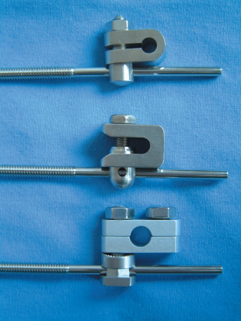
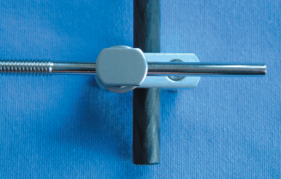
Standard K-E Clamp
Securos Clamp and IMEX-SK Clamp
IMEX-SK Clamp

Slide 25
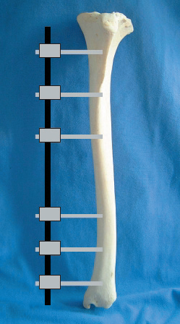
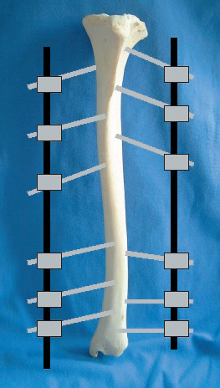

Slide 26
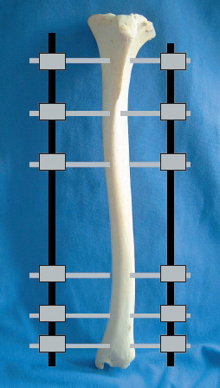
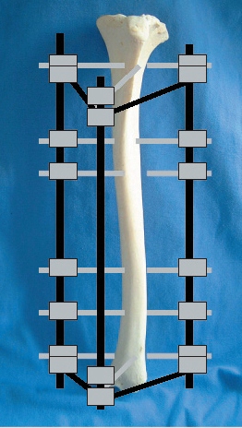

Slide 27
Stage 1: Fracture Planning
Fracture configuration assessed using well positioned and correctly exposed orthogonal radiographic views
Identify any fissures that could split on pin insertion
A ‘fracture plan’ should be made by tracing fragments and then ‘reconstructing’ the bone, enabling a scaled plan of the repair to be drawn
Advisable: ‘plan B’ (alternative frame or fixation method)!

Slide 28
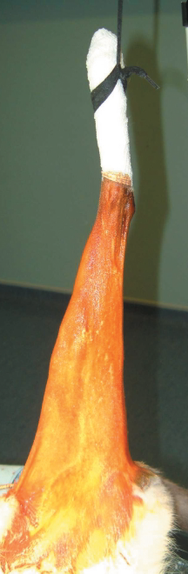
Stage 2: Preparation
‘hanging limb’ technique is recommended as this helps to realign the fracture, and stretch and fatigue the muscles
Towel clips should be clipped onto a toenail or through a sterile bandage wrapped around the foot

Slide 29
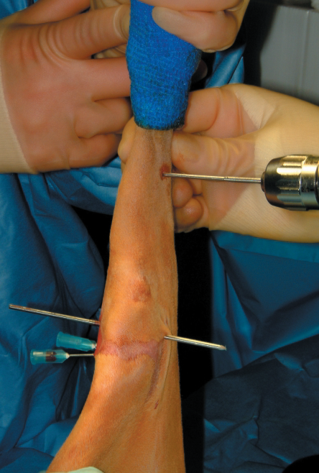
Stage 3; Applying the Fixators
Pins must be placed through ‘safe corridors’, to avoid major neurovascular tracts, muscle masses and tendons.
Do not place pins into growth plates in immature animals
Place hypodermic needles into the joint spaces to act as temporary markers.

Slide 30
Place the most proximal and distal pins first, preferably
parallel to the adjacent joint surfaces.
Attach the connecting bar(s).
Insert the remaining pins through the clamps. Ideally,
a minimum of six cortices should be engaged in each of
the main proximal and distal fragments.
Threaded pins should be inserted parallel to each

Slide 31
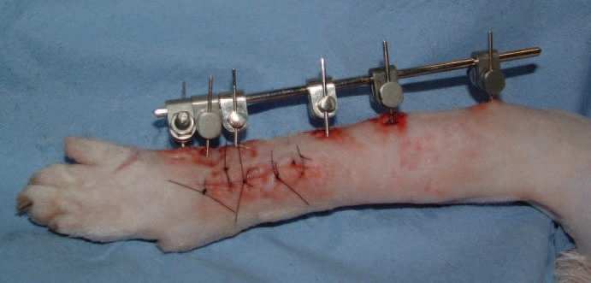

Slide 32
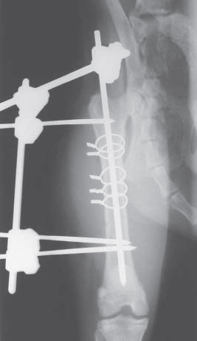
Stage 4:Postoperative radiography
Orthogonal views should be taken to assess:
  Fracture alignment and reduction
  Pin position

Slide 33
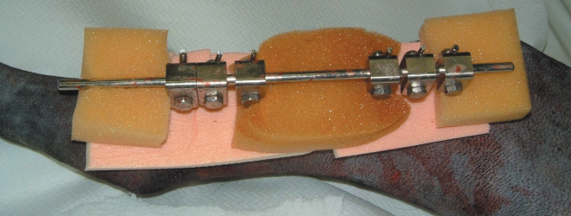
Stage 5: Immediate postoperative care
An inner layer btwn frame and the skin to:
  reduce skin movement and swelling and absorb discharge.
  maintained until pin tracts have stopped discharging (four to five days).

Slide 34
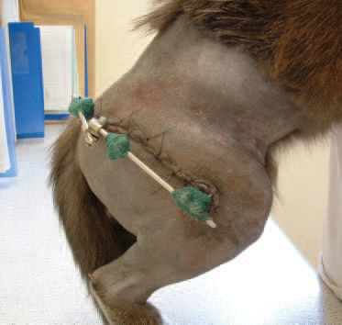
A second (outer) layer covers frame at all times to decrease the likelihood of the frame catching and being pulled off, and to protect the owner’s legs and furniture!
Distal limb bandaged for the first 24to 48 hours to reduce postoperative swelling.

Slide 35
Stage 6: Follow-up Assessment
Radiographs 3-4 wks postop if immature or 6 wks in adults
Clinical union occurs before radiographic union

Slide 36
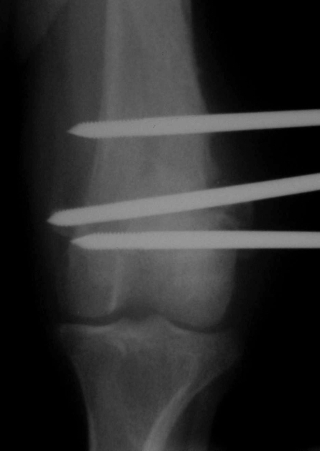
Complications
Premature pin loosening
Results from a failure of the pin-bone interface
Clinically, causes pain, inflammation and discharge from the pin tract, and leads to increased lameness
A radiolucent line around pin, as bone is resorbed & replaced by fibrous connective tissue

Slide 37
CONTINUED INSTABILITY causes further resorption and
can lead to infection or, in extreme cases, sufficient bone
weakening to cause fracture.
Loosening of a single pin is to be expected, but loosening of several pins suggests that the frame is too weak, or that the surgical technique has been poor.
PIN BREAKAGE is rare.

Slide 38
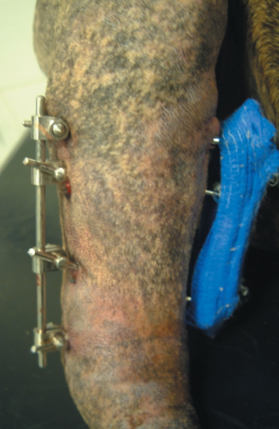
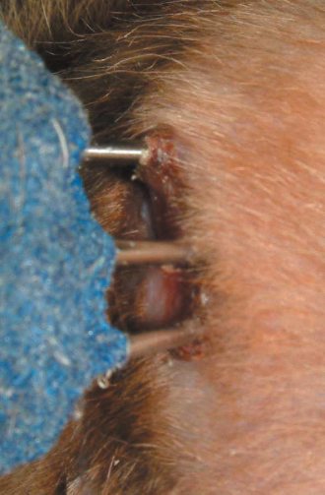
Frame Failure
Pin Tract Infection
Catastrophic frame failure occurs only if required strength of frame was seriously underestimated

Slide 39
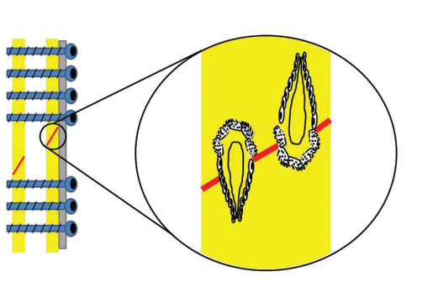
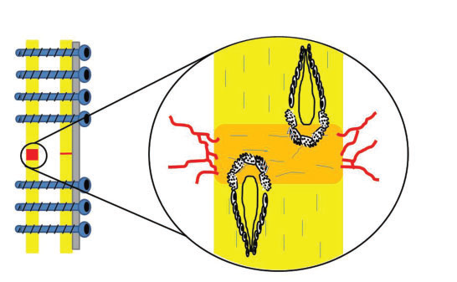
Primary bone healing
Primary healing
Gap healing

Slide 40
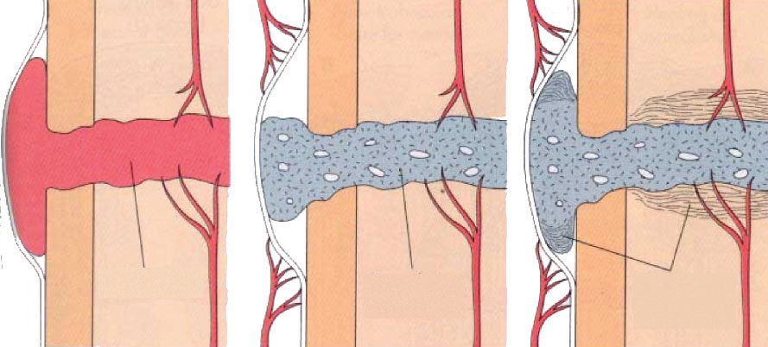
Secondary bone healing

Slide 41
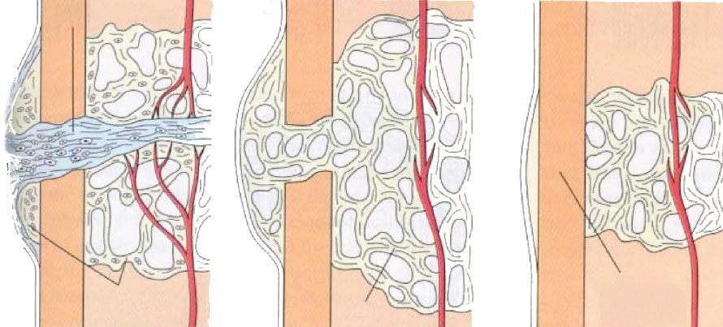

Slide 42
Intramedullary Pins and Kirshner Wires
Indications:
  Diaphyseal fractures of the humerus, femur, tibia, ulna and metacarpal and metatarsal bones
Contraindications:
  Radius because insertion point of pin interferes with the carpus
  Mandible because the pins will damage the blood supply
Biomechanical advantage:
  resistance to applied bending loads: unlike bone plates & external fixators

Slide 43
Biomechanical disadvantages:
  poor resistance to axial (compressive) or rotational loads and
  lack of fixation (interlocking) with bones
Friction created btwn pin and bone prevents premature pin migration:
  The stress associated with unstable fractures results in
    microtrauma at the pin-bone interphase,
    bone resorption and
    pin migration

Slide 44
IM Pins should be supplemented with other implants (cerclage wire and external fixators or plates) to increase rotational and axial support
Steinmann pins or Kirshner wires may be
  used as cross-pins (wires) or
  placed in a triangulated pattern to stabilize metaphyseal and physeal fractures in young animals
  Kirshner wires are also used as IM pins in very small animals

Slide 45
Chisel points have a two-sided cutting edge that is slightly more effective in cutting through dense cortical bone (generates less heat than trocar points)
Trocar points
  Have triple cutting edge and
  Cut through cancellous bone easily
  Are most often used

Slide 46
IM Pins may be smooth or threaded near the end
Kirshner wires are small in diameter, ranging from 0.035 Inc to 0.062 Inc smooth pins, which generally have trocar points on each end
IM pins are driven with a Jacobs chuck (with a key)
IM pins and Kirshner wires used as crossed pins may be driven with a high speed wire driver

Slide 47
Application
IM Pin may be normograded or retrograded [Femur or Humerus]
IM Pins must be normograded in canine tibia : [damage stifle joint]
Advantages of normograde placement:
  The pin can be placed more precisely
  There is less manipulation of the fracture area
Disadvantage of normograde placement: it may be difficult to identify the correct entry point into the bone if the insertion of the pin is done blindly

Slide 48
Span the length of the bone with the IM pin
  Use retrograde or normograde pin insertion [humerus and femur]
  Use normograde pin insertion in the tibia
  Check pin location with reference pin and by manipulating the joint
  Always use additional fixation to control rotation and axial loading

Slide 49
Orthopaedic Wire: (Cerclage or Hemicerclage Wire)
Used in combination with other implants to
    supplement axial rotation and bending support of fractures
Cerclage Wire:
  Denotes the use of orthopaedic wire placed around the circumference of the bone
Hemicerclage Wire (Interfragmentary Wire):
  Denotes wire that is placed through predrilled holes

Slide 50
Key Concepts
  Use only on anatomically reconstructed long oblique or spiral fractures
  Use 18-gauge wire for large dogs and 22-gauge or 20-gauge wire for cats and small dogs
  Place two to three cerclage wires per fracture line

Slide 51
  Place wires perpendicular to the long axis of the bone
  Space wires one half to one bone diameter apart
  Support cerclage wires with an IM pin, interlocking nail, external fixator or plate

Slide 52
Bone Plates and Screws
Bone plates can stabilize
  long bone fracture and fractures of the axial skeleton
  Are imperative for fractures involving joint surfaces
  Useful when Postop comfort and early limb use are desired
Screws used as lag screws cause compression at the fracture, increasing the friction between fragments and resisting forces acting on fracture

Slide 53
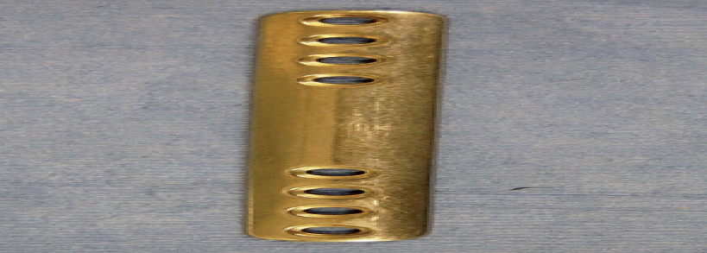
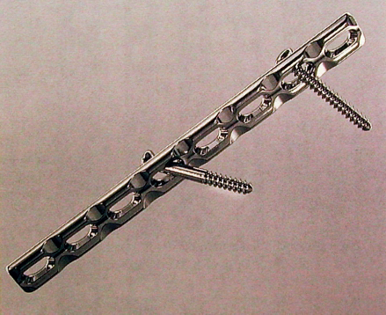

Slide 54
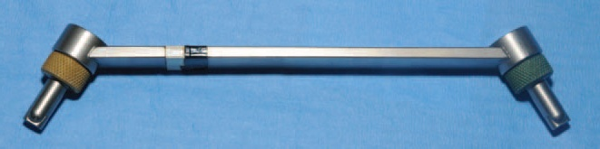
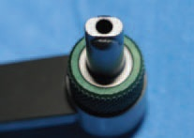
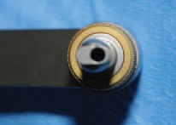
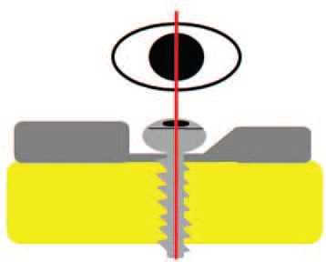

Slide 55
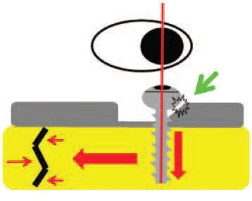
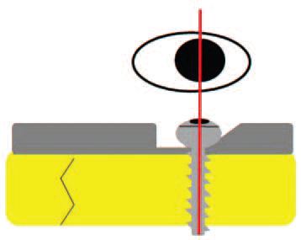

Slide 56
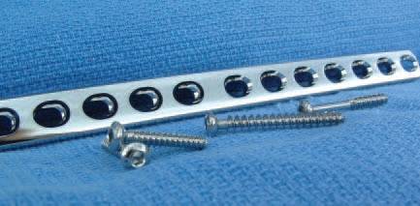

Slide 57
Bone plates
  Effectively resist axial loading, bending and torsional forces acting on fractured bones
  Are susceptible to repeated bending stresses because of the plate’s location in relationship to the long axis of the bone
  Implant fatigue failure: when opposite cortex is not reconstructed and fails to bridge with bone early enough to protect plate
  Plate holes concentrate stress, and failure occurs in this area

Slide 58
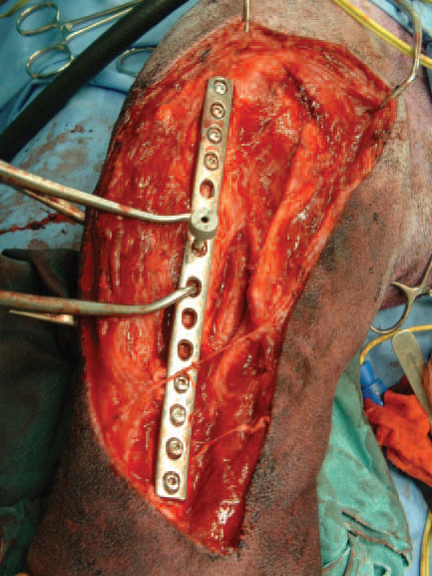

Slide 59
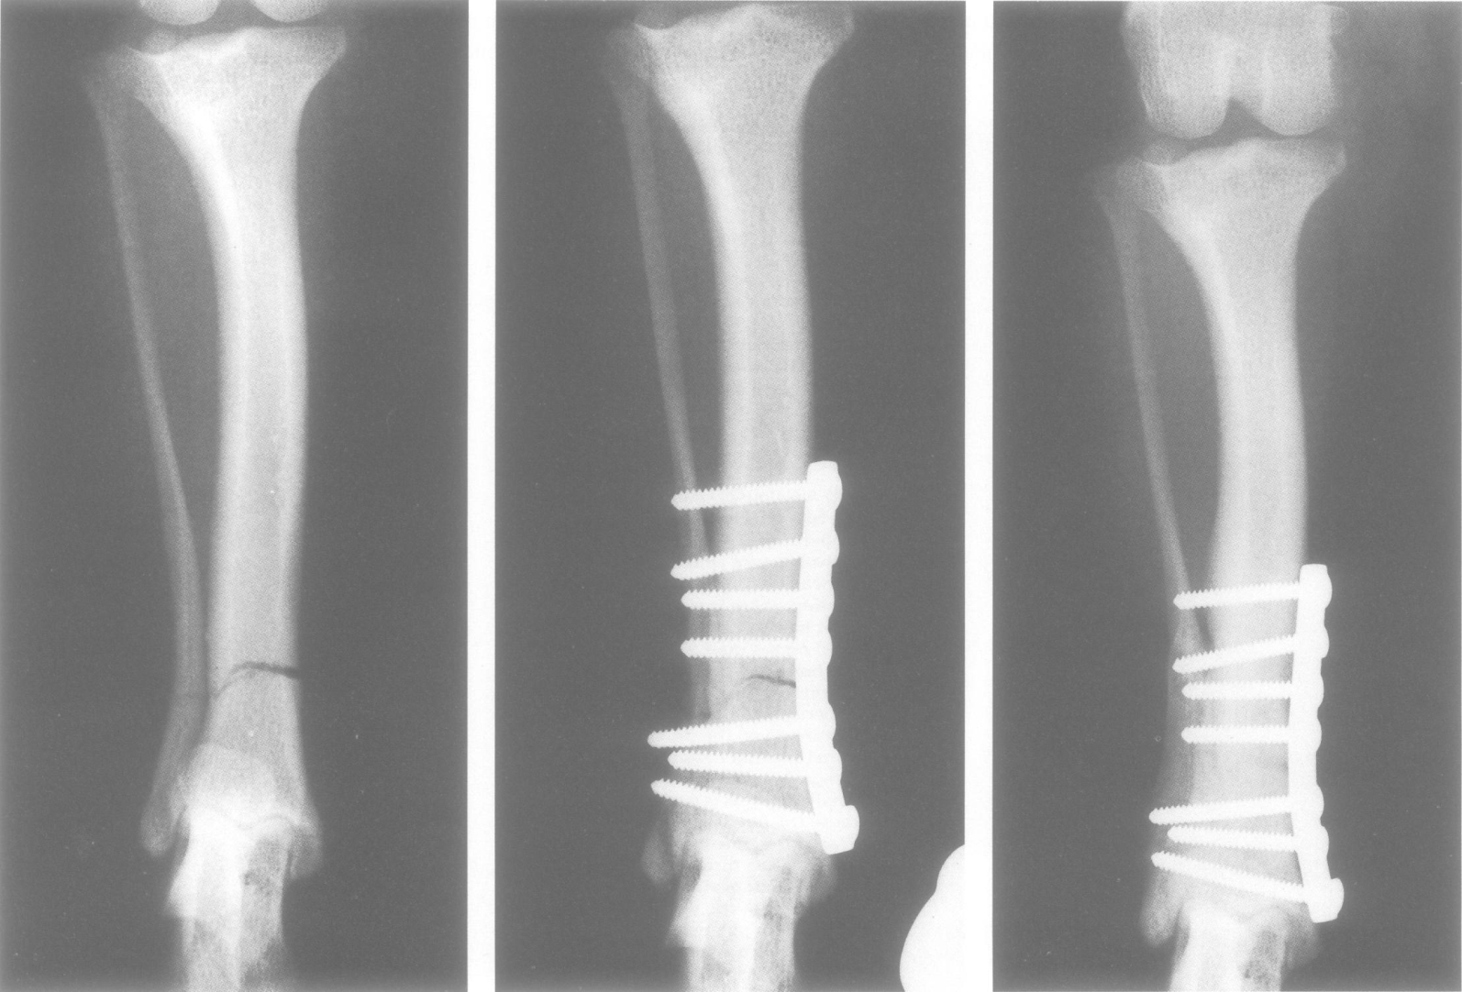

Slide 60
Cortical screws
Fully threaded and designed for use in compact bone
The pitch (number of threads per inch) of the screw is greater than that of a cancellous screw
This allows a greater number of threads to engage the matrix of the relatively narrow-diameter cortical bone

Slide 61
Cancellous screws
Are either completely or partially threaded
Are used primarily in the epiphysis or metaphysis
Thread height of cancellous screws is greater than thread height of cortical screws
  This allows deep purchase into the soft, spongy epiphyseal or metaphysical bone

Slide 62
Bone screws are used either to
  anchor bone plates, (called plate screws) or
  hold bone fragments in anatomic position and prevent them from collapsing into the marrow cavity (called position screws)
  apply compression between fragments (lag screws)

Slide 63
Key Concepts in Applying Lag Screws
  Reduce and secure the fracture before placing the lag screws
  For optimal compression, place the screw perpendicular to the fracture
  Drill the near cortex with a bit equal to the screw thread diameter

Slide 64
Compression Plates
  These are used to generate axial compression at the fracture
  To achieve this function, it is important to contour the plate properly relative to the bone surface

Slide 65
Neutralization Plates
  The neutralization plate protects the reconstructed bone from all torsional, bending and shearing forces
  The recommended number of cortices (six) engaged on each side of the fracture is the same as for a compression plate

Slide 66
Bridging Plates
Bridging plate
  serves as a splint to maintain the spatial alignment of the bone during healing
  All the applied loads will be carried by the plate and screws during the early postoperative period
  This results in greater stress on the bone screws than with compression or neutralization plates, in which the applied loads are shared with the bone

Slide 67
Buttress Plate
The buttress plate functions to prevent collapse of the adjacent articular surface

Slide 68
Removal of Bone Plates in Small Animals
Normally not removed
When the plates become non functional (loose, broken or bent); they no longer serving a useful purpose and cause discomfort
Thermal conductivity; discomfort in cold weather;
Due to difference in expansion and contraction of the plate and bone under changing temperature and by the thermal mass of the plate chilling the periosteum
Bone plate causing osteoporosis as a result of remodeling due to vascular interference by the plate on the bone surface

Slide 69
Interference with bone growth in young animals
Bone plate irritation leading to a lick granuloma and lameness
Infection remove the implant to avoid fracture-associated sarcomas
Impediment of full functional performance in field and racing animals

Slide 70
Policy on removal
All pelvic plates are left in place, unless complications
All plates are left in place in skeletally mature animals following uncomplicated healing; those involving infection, delayed union or non-union should be removed
Remove plates on long bones in all skeletally immature animals after clinical union;
Ideally, remove all plates on long bones; limited by economics

Slide 71
In dogs less than 3 months old, remove after 4 months
In dogs between 3-6 months, remove after 2-3months
In dogs 6-12 months, remove after 3-5 months
In dogs over 12 months, remove after 5-14 months

Slide 72
Refracture can occur due to;
  Premature implant removal
  Poor anatomical reduction
  Osteoporotic bone

Slide 73
Postoperative Care
Check radiographic appearance and activity of the patient
Apply a compression bandage over the operative area 2-3 days to prevent hematoma or seroma formation
Supportive measures if there is
  radiographic evidence of suboptimal bone healing
  Osteoporosis under the plate
Restriction of activity for 1-4 wks (confinement, kennel or house rest, walking on a leash, or restricted play

